Slide 1
Lecture 16
MRI magnets Read section 5.14 from Smith and Webb for magnets

Slide 2
We now understand why the steady (1.5T) and the RF magnets (~ mT) are there.
But why do we need the third magnet in the MRI set-up?

Slide 3
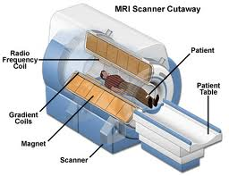
What magnetic fields do we have?
Steady magnetic field, B_{o} (initially aligns spins)
B₁
RF magnetic field, B₁ (excites aligned spins)
Spatial information
B_{o}

Slide 4
Gradient coils
Sections 5.8 and 5.9 from Smith and Webb

Slide 5
Localizing the signal
We still don’t have a way to distinguish the magnetic resonance signals coming from protons in different locations in the body. We need to localize the signal.

Slide 6

Pulsed gradients (~ milliseconds)
G (~10 mT/m) << B_{o} (~ 1.5 T)
Over 30 cm, total field variation is ~ 3mT (0.2% of B_{o})
Expressed in units of change in resonant frequency per cm (Hz/cm). For protons 10 mT/m = 4,258 Hz/cm.

Slide 7
z-gradient (G_{z}): Slice selection
y-gradient (G_{y}): Phase encoding
x-gradient (G_{x}): Frequency encoding

Slide 8
Step 1. Slice selection

Slide 9
Magnetic field is B_{o} at the isocentre
Gradient in z-direction
isocentre
B₀
y
z
x

Slide 10
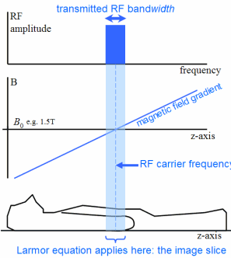
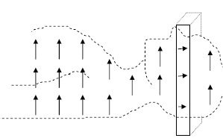
Slice selection

Slide 11
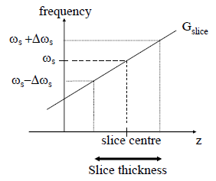
Slice thickness
G_{z}
= γ (z G_{z})
Slice thickness: 2Δω_{s}/γG_{z}

Slide 12
All spins in the slice have same precessional frequency

Slide 13
Step 2. phase encoding

Slide 14

Apply phase encoding (PE) gradient pulse (G_{y})
Slower unchanged faster

Slide 15
After PE Gradient is turned off, all spins have same frequency again, but different phase
-90° 0° +90°

Slide 16
Step 3. frequency encoding

Slide 17
Faster Unchanged slower
Apply frequency encoding gradient (G_{x})
Remains on during read-out of RF signal.
Each spin will precess with a unique frequency

Slide 18
Watch the video links shared on Moodle

